Slide 1

Parallel Correlation Clustering on Big Graphs
Dimitris Papailiopoulos UC Berkeley

Slide 2





Joint Work With
Xinghao
Pan
Samet
Oymak
Ben
Recht
Kannan
Ramchandran
Michael I.
Jordan

Slide 3
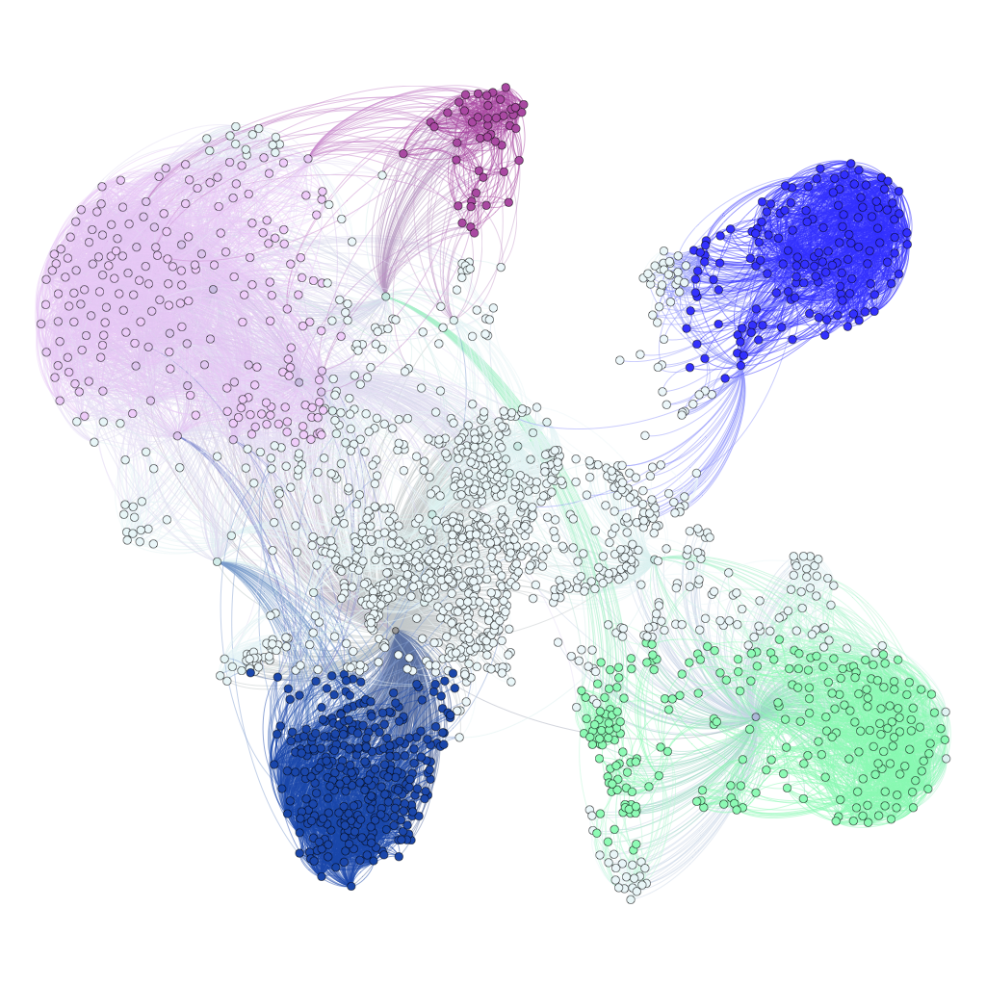
What is this talk about?
Correlation Clustering
How can we scale up?
ClusterWild!: A novel Asynchronous algorithm for Parallel CC
Theory
Practice
Noisy viewpoint:
Asyncronous( Algorithm( DATA ) ) Algorithm( DATA + Noise )
Clustering Billion-edge Graphs in 5 sec.
on 32 threads on Amazon EC2

Slide 4
Correlation Clustering

Slide 5
Correlation Clustering
We are given a graph,
with similar and dissimilar vertices
dissimilar
similar
[Bansal, Blum, Chawla FOCS’02]
Goal: Group vertices in clusters so that
Similar ones are together
Dissimilar are apart
Objective:
minimize un-happy pairs

Slide 6
Correlation Clustering
Clustering Ex.
Def:. Unhappy pairs:
- similar nodes in different clusters
- dissimilar nodes in same cluster
Objective:
minimize un-happy pairs

Slide 7
Correlation Clustering
Clustering Ex.
Cost = 1 unhappy pairs
Def:. Unhappy pairs
- similar nodes in different clusters
- dissimilar nodes in same cluster
Objective:
minimize un-happy pairs

Slide 8
Correlation Clustering
Clustering Ex.
Cost = 2 unhappy pairs
Def:. Unhappy pairs
- similar nodes in different clusters
- dissimilar nodes in same cluster
Objective:
minimize un-happy pairs

Slide 9
Application: Deduplication
similar
UC Berkeley
Stanford University California
UC Berkeley
Stanford University California
University of California at Berkeley
University of California at Berkeley
Lawrence Berkeley National Labs
Lawrence Berkeley National Labs
Note:
Missing edge = dissimilarity

Slide 10
Application: Deduplication
Note:
Missing edge = dissimilarity
Correlation Clustering:
Cluster to minimize unhappy pairs (clustering error)

Slide 11
Application: Deduplication
NP Hard!
Lot’s of prior work:
-Approximation algorithms
-Statistical Guarantees
-many variants
[AilonCharikarNewman08], [AilonLiberty09], [CharikarGuruswamiWirth03], [DemainFiat06]…[MathewSchudy10], [MakarychevMackarychevVijayaraghavan14] [ChierichettiDalviKumarKDD14] , [Bonchi et al KDD14], [Puleo, Milenkovic, 15]
Many more Applications:
Community Detection
[Yang, Cheung, Liu, TKDE’ 07]
Opinion/Trust Network Link Classification
[C.-Bianchi, Gentile, et al, COLT’12]
Co-reference Resolution
[Soon et al., CompLing ’01], [McCallum, Wellner. NIPS’04]
Gene Clustering
[Ben-Dor, Shamir, Yakhini, JCompBio ’99]
Consensus Clustering
[Goder Filkov, ‘08]

Slide 12
Goal of this work: Provable Correlation Clustering for Billion-edge Graphs

Slide 13
A Serial Algorithm: Peeling
Serially process vertices
active
Nir Ailon, Moses Charikar, and Alantha Newman.
Aggregating inconsistent information: ranking and clustering.
Journal of the ACM (JACM), 55(5):23, 2008.

Slide 14
A Serial Algorithm: Peeling
Serially process vertices
active
Nir Ailon, Moses Charikar, and Alantha Newman.
Aggregating inconsistent information: ranking and clustering.
Journal of the ACM (JACM), 55(5):23, 2008.

Slide 15
A Serial Algorithm: Peeling
Serially process vertices
active
Nir Ailon, Moses Charikar, and Alantha Newman.
Aggregating inconsistent information: ranking and clustering.
Journal of the ACM (JACM), 55(5):23, 2008.

Slide 16
A Serial Algorithm: Peeling
Serially process vertices
Can we parallelize? Issue:
Seems Inherently Sequential…
In practice:
good performance after local improvement heuristics
[Elshner, Shudy ’09]
Approximation 3 OPT (in expectation)
Nir Ailon, Moses Charikar, and Alantha Newman.
Aggregating inconsistent information: ranking and clustering.
Journal of the ACM (JACM), 55(5):23, 2008.

Slide 17
How do we parallelize Peeling?

Slide 18
Parallel Sampling ``Activate” vertices / round similar to [Blelloch et al.12], [Chierichetti et al KDD’14]
active
active

Slide 19
What if active vertices are friends?
Concurrency rule:
No clusters between active friends
Two Novel Algorithms [NIPS2015]:
active
C4
Follow rules:
Provably fast 3*OPT parallel CC
(using Concurrency Control Pan et al.)
ClusterWild!
Break rules:
a faster coordination-free
3*OPT+error parallel CC
(a combinatorial HOGWILD [Niu, Recht, Re, Wright])
active

Slide 20
What if active vertices are friends?
Concurrency rule:
No clusters between active friends
Two Novel Algorithms [NIPS2015]:
active
ClusterWild!
Why Break Rules?
Because, cores will not need to coordinate
Faster parallel algorithm
Q: how bad is it to break rules?
active

Slide 21
ClusterWild!: An Asynchronous, Coordination-free Approach
active
active

Slide 22
ClusterWild! An Asynchronous Coordination-free Approach
Cannot introduce
adjacent cluster centers
Go Hogwild!
active
active
Not free:
We lose accuracy (Q: how much?)

Slide 23
How to analyze ClusterWild!?
Cannot introduce
adjacent cluster centers
active
active
Aha! It’s like that edge was never there!!
It’s like Serial algo. on a “noisy”graph!

Slide 24
How much is noise hurting me?
Idea:
Cost(Break Rules) = Cost(Follow Rules)+#extra unhappy pairs
Break Rules
Follow Rules
versus
active
active
active
active

Slide 25
How much is noise hurting me?
Idea:
Cost(Break Rules) = Cost(Follow Rules)+#extra unhappy pairs
Extra unhappy pairs = Edges cut across clusters
Break Rules
Follow Rules
versus

Slide 26
How many unhappy pairs?
Def:
= Bad Triangle
Charge unhappy pairs to Bad Triangles (+ignored edges)
#Bad Triangles due to edge “deletions”?
Lemma:
#Bad Triangles < (#Edges ignored) * (max degree)
Lemma:
#Bad Triangles < εV log V

Slide 27
Main Theorem [NIPS2015]
ClusterWild!
If P is the #cores <
Then, ClusterWild! Achieves an approximation ratio of
with running time
Proof Ingredients:
- LP duality bounds
Lock-free(Algorithm( Graph )) = Algorithm( Graph+Noise )
Show Progress => Max.Deg decays exponentially fast

Slide 28
Experiments
Implementation in Multicore Scala
Experiments on Amazon EC2’s r3.8xlarge
Specs: 32 vCPUs, 244GBs RAM
Graph | # vertices | #edges
IT-2004 | 41 million | 1.1 billion
WebBase-2001 | 118 million | 1.0 billion

Slide 29
Running Time on Billion-edge Graphs
Clustering Billion-Edge Graphs in 5 sec.
12-15x Speedup on 32 threads

Slide 30
Conclusions
Provable Clustering for Billion-Scale Graphs
Large Scale Implementation (Scala multicore tested on EC2)
Meta-framework for HOGWILD! (async. parallel) algorithms
Applied on async. ML (SGD, SCD, SVRG,…). Simple + Intuitive
[Mania, Pan, Papailiopoulos, Recht, Ramchandran, Jordan, 2015]
- Trying to close the loop of
Theory + Practice
ML+ Systems
Noisy viewpoint:
Asyncronous( Algorithm( DATA ) ) Algorithm( DATA + Noise )

Slide 31
fin

